Slide 1
Chapter 7: Managing Users, Computers, and Groups
Instructor-led overview and operational guidance

Slide 2
Learning Objectives
01 Explain the key administrative ideas in Chapter 7
02 Identify the relevant Windows Server tools, workflows, and decision points
03 Relate the topic set to real operational and security practices
04 Prepare for later hands-on administration and troubleshooting work
Windows Server 2025 | Chapter 7 | Managing Users, Computers, and Groups
02

Slide 3
Chapter Topics
01 7.1 Local users
02 7.2 Active Directory basics
03 7.3 Domain users
04 7.4 Groups
05 7.5 Computers
Windows Server 2025 | Chapter 7 | Managing Users, Computers, and Groups
03

Slide 4
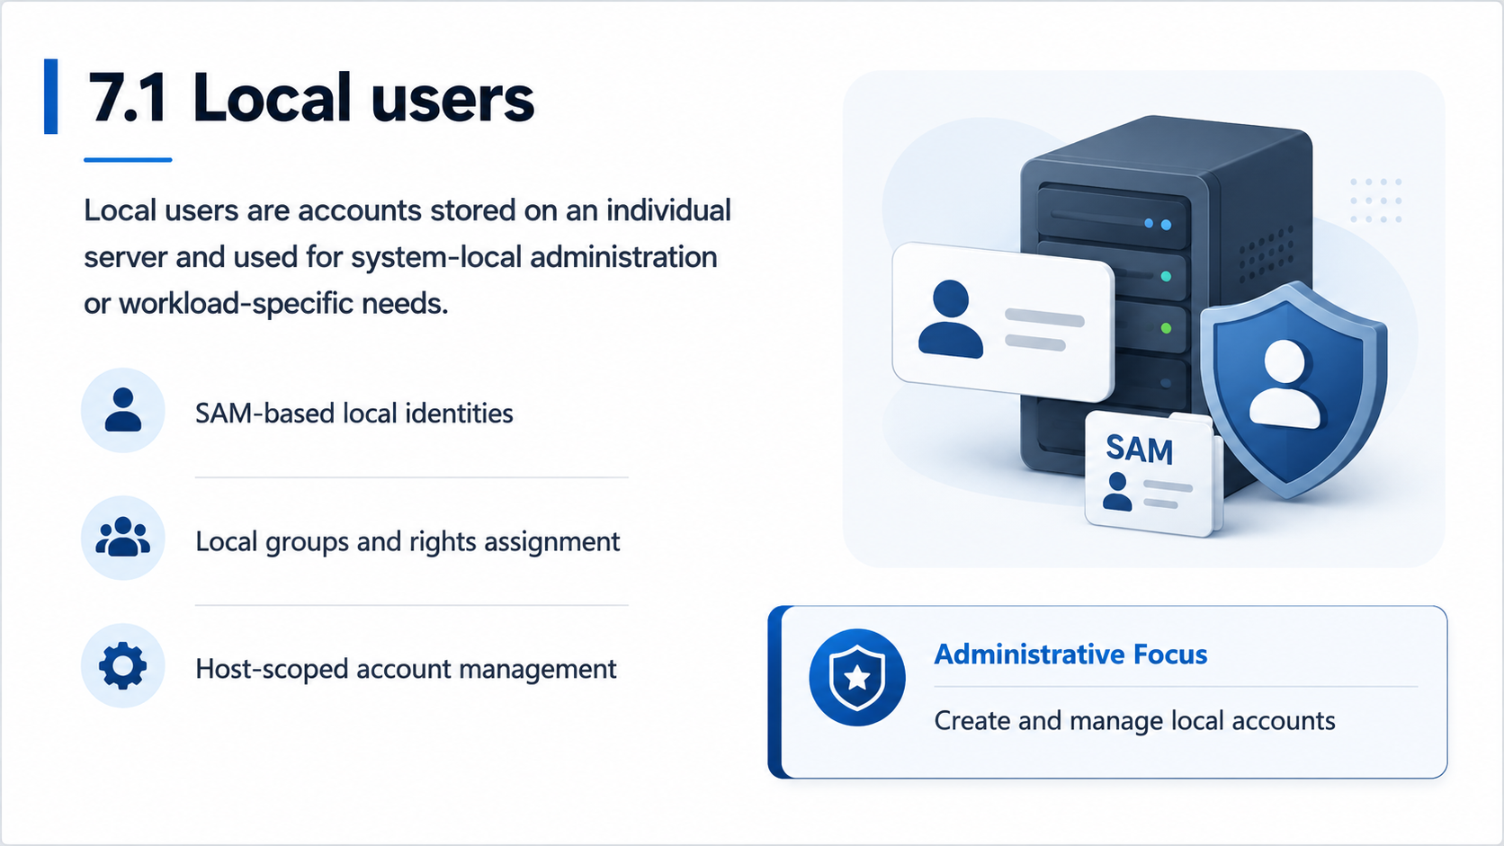

Slide 5
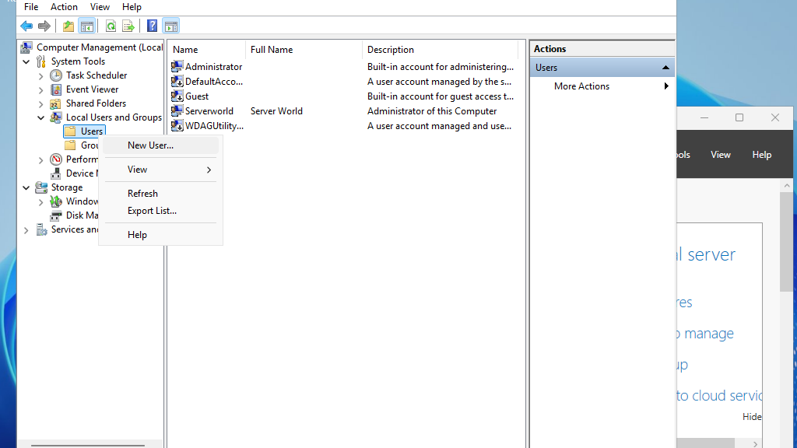
Local Users and Groups
Windows Server 2025 | Chapter 7 | Managing Users, Computers, and Groups
05

Slide 6

7.6 What is Active Directory?
Active Directory (AD) is Microsoft's directory service for Windows domain networks, providing centralised authentication, authorisation, and resource management.
Domain Services (AD DS) — stores directory data; authenticates and authorises users and computers
Hierarchical structure — Forest > Domain > Organisational Unit (OU) > Objects
Objects — users, computers, groups, printers, policies stored in NTDS.DIT database
Kerberos authentication — default protocol; uses ticket-based SSO across domain-joined resources
LDAP — Lightweight Directory Access Protocol used to query and modify AD objects
Domain Controllers (DCs) — servers hosting AD DS; handle auth requests and replicate directory changes
Key Fact
AD was introduced with Windows 2000 Server and remains the standard identity platform for on-premises Windows environments
Windows Server 2025 | Chapter 7 | Managing Users, Computers, and Groups
07

Slide 7
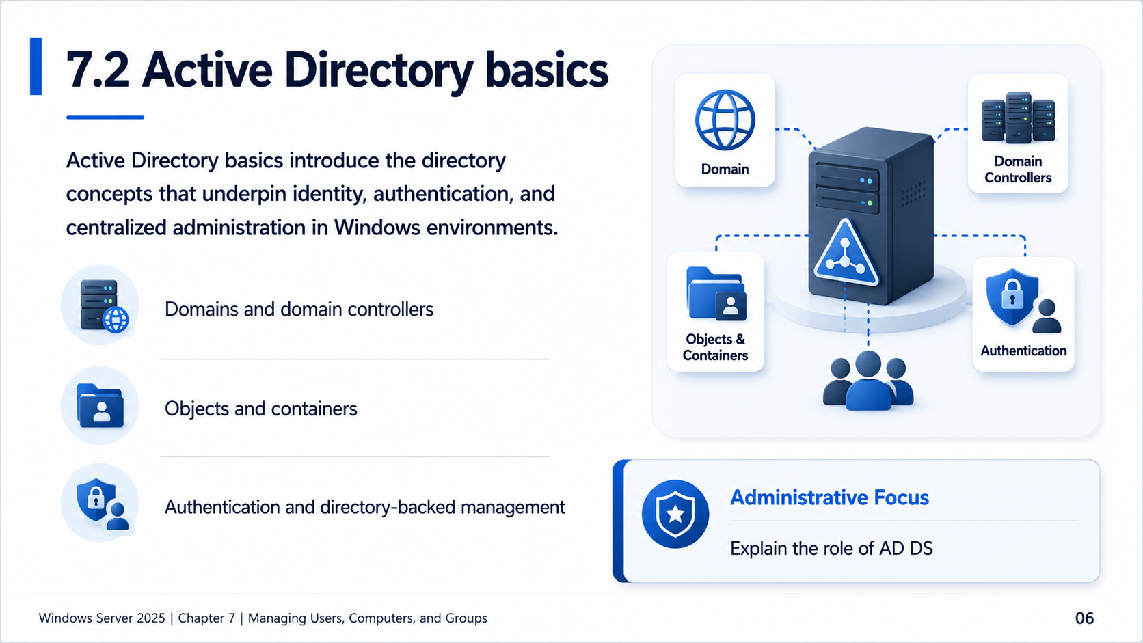

Slide 8
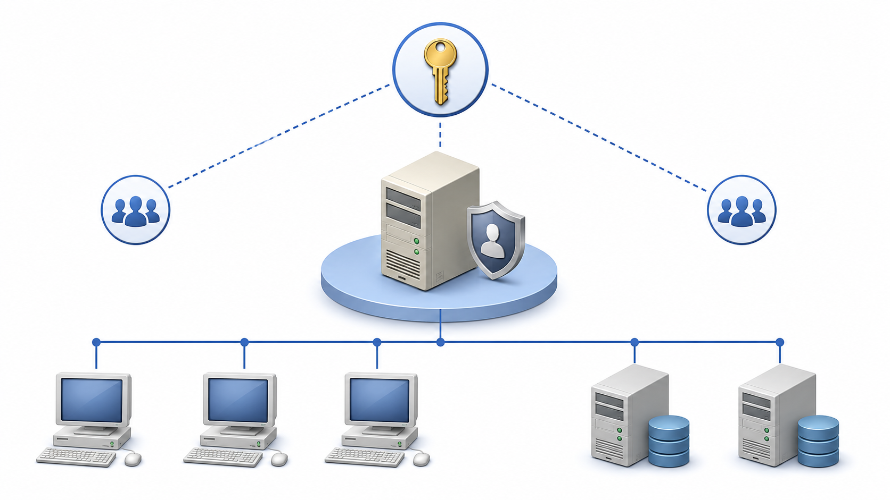
7.2A Before Active Directory
Windows NT domains provided central sign-in, but management was flatter and more server-centric.
P
Primary Domain Controller
One writable PDC accepted account changes; BDCs received replicated copies.
T
Trust-heavy designs
Large environments often used multiple domains and manual trust relationships.
S
SAM-based accounts
The account database was less flexible than a searchable, hierarchical directory.
✓
Administrative Focus
Explain what Active Directory replaced
Windows Server 2025 | Chapter 7 | Managing Users, Computers, and Groups
08

Slide 9
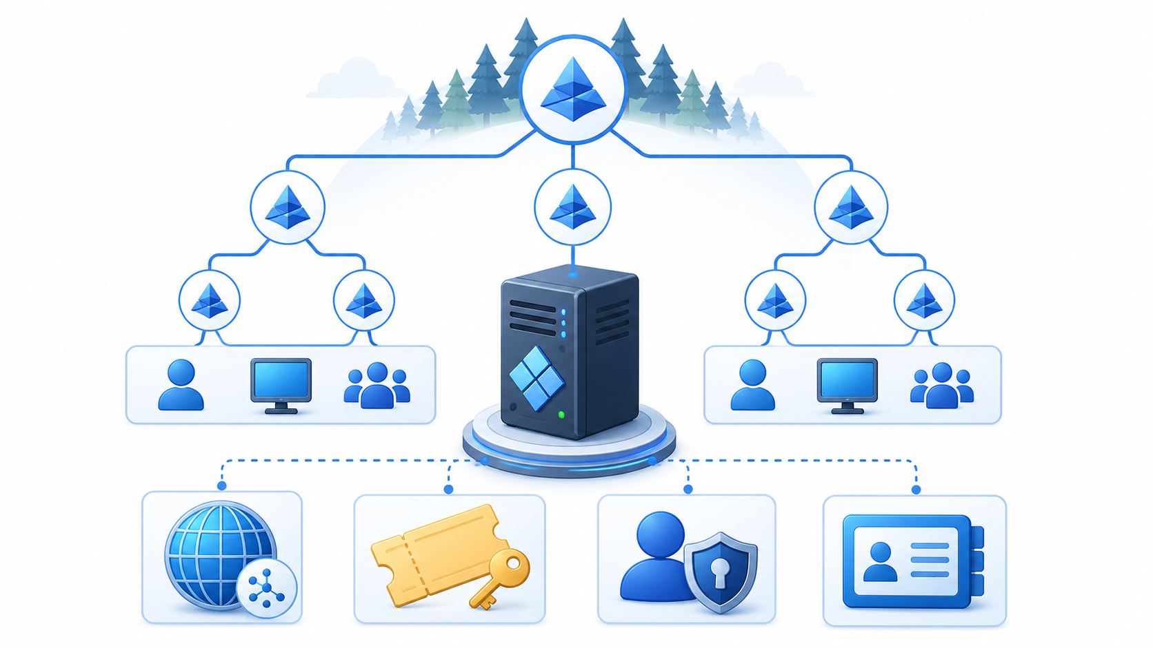
7.2B Windows 2000: AD arrives
Active Directory moved Windows identity from flat domains to a hierarchical directory service.
Hierarchical model
Standards-based
Forest > Domain > OU > Objects
LDAP, DNS and Kerberos
Multi-master DCs
Central policy
Changes replicate between domain controllers
Group Policy and delegation
✓
Administrative Focus
Describe the design shift AD DS introduced
Windows Server 2025 | Chapter 7 | Managing Users, Computers, and Groups
09

Slide 10
7.2C Active Directory evolution
AD DS kept the same core directory idea while adding scale, automation, security, and hybrid support.
2000
2003
2008
2012
2016+
2025
AD introduced
Forest maturity
Security & recovery
Automation
Privileged access
Modernisation
LDAP, Kerberos, DNS
Trusts and replication
RODC, FGPP, Recycle Bin
ADAC, PowerShell, gMSA
PAM and hardening
32K pages, dMSA, crypto
Key pattern: AD was not replaced by every Windows Server release — new functional levels, management tools, and security features built around a stable directory core.
Windows Server 2025 | Chapter 7 | Managing Users, Computers, and Groups
10

Slide 11
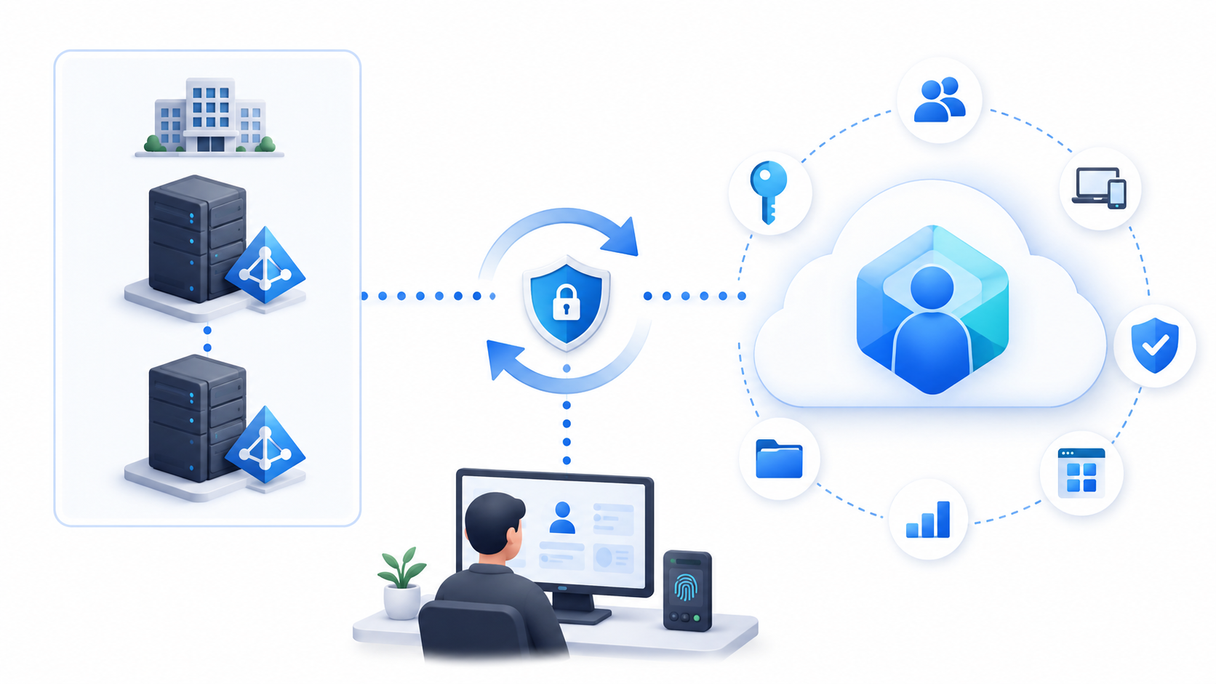
7.2D Active Directory today
AD DS remains the on-premises identity backbone while cloud identity handles modern SaaS and device scenarios.
K
Kerberos and LDAP still matter
File servers, legacy apps, domain-joined computers, and GPO often depend on AD DS.
G
Group Policy remains central
AD continues to target policies, scripts, security settings, and admin structure.
H
Hybrid identity is common
AD identities are often synchronised to Microsoft Entra ID for cloud services.
✓
Administrative Focus
Connect AD history to current administration and security design
Windows Server 2025 | Chapter 7 | Managing Users, Computers, and Groups
11

Slide 12
7.7 Active Directory - Windows Server 2025 Changes
Windows Server 2025 delivers the most significant Active Directory update since Windows Server 2016, spanning scalability, security, and management.
32K database page size — optional feature; increases multi-value attribute limit from ~1,200 to ~3,200; requires all DCs on WS2025
New forest/domain functional level — DomainLevel/ForestLevel 10; required for 32K page size feature
Delegated Managed Service Accounts (dMSA) — seamlessly migrate unmanaged service accounts; deactivates old account automatically
Kerberos PKINIT cryptographic agility — adds AES-SHA256/384 support; RC4 deprecated; removes hardcoded algorithms
Replication priority boost — admins can now prioritise DC-to-DC replication instead of relying on hardcoded priority numbers
Enhanced LDAP security — LDAP sealing by default after SASL auth; TLS 1.3 support; confidential attributes require encrypted connections
Enable 32K Pages
Enable-ADOptionalFeature -Identity 'CN=32K DB Pages...'
Windows Server 2025 | Chapter 7 | Managing Users, Computers, and Groups
08

Slide 13
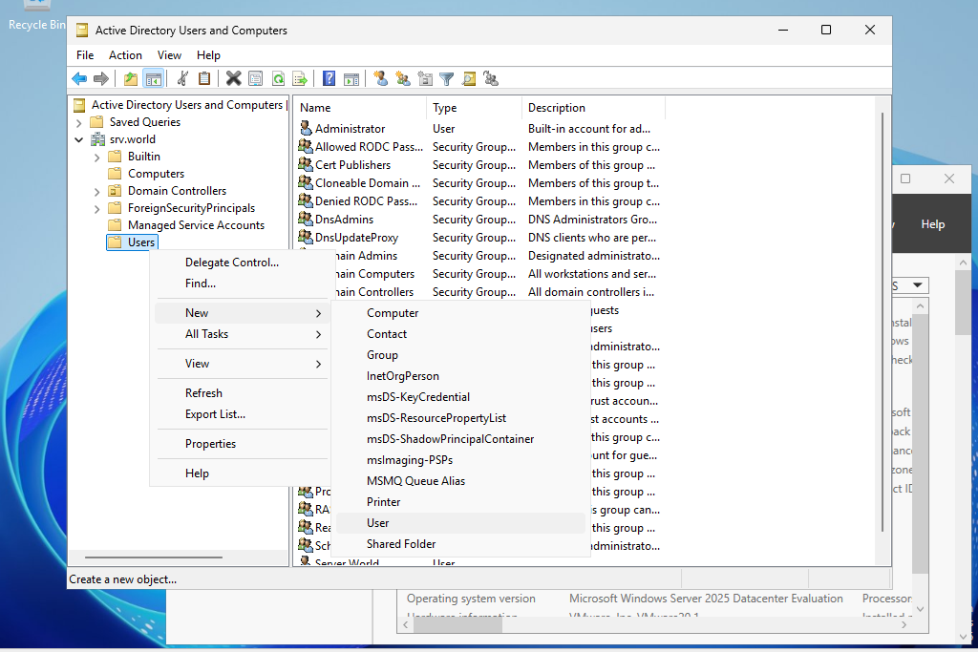
Active Directory Users and Computers
Windows Server 2025 | Chapter 7 | Managing Users, Computers, and Groups
09

Slide 14
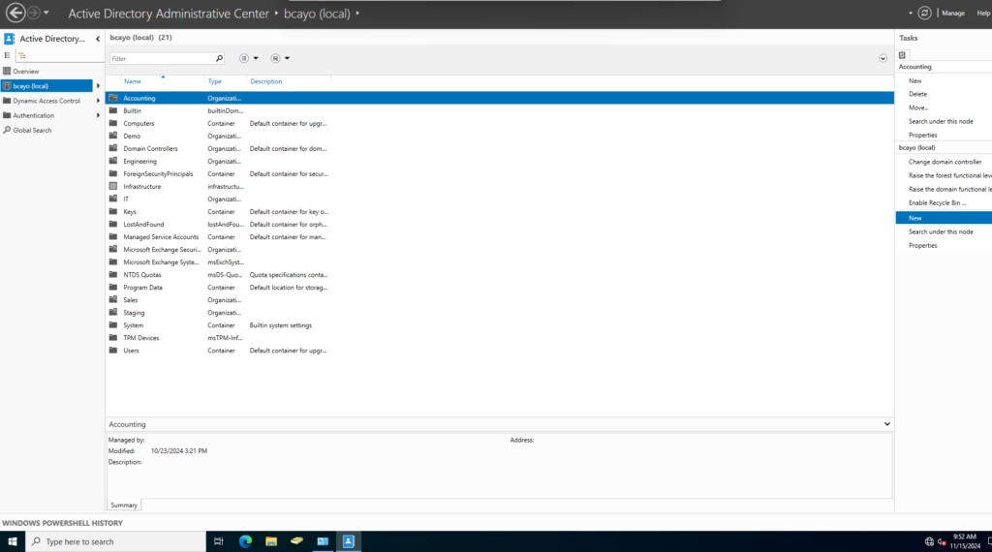
Active Directory Administrative Center
Windows Server 2025 | Chapter 7 | Managing Users, Computers, and Groups
10

Slide 15

7.3 Domain users
Domain users are directory-based identities managed centrally through Active Directory.
User objects and attributes
Authentication and sign-in scope
Centralized policy and administration
Administrative Focus
Create and manage user accounts
Windows Server 2025 | Chapter 7 | Managing Users, Computers, and Groups
11

Slide 16

7.4 Groups
Groups simplify administration by assigning permissions and rights to collections of identities instead of to individual accounts.
Security and distribution groups
Scope and nesting considerations
Role-based access management
Administrative Focus
Create groups
Windows Server 2025 | Chapter 7 | Managing Users, Computers, and Groups
12

Slide 17
7.5 Computers
Computer objects represent managed systems in Active Directory and are used for policy application, trust relationships, and operational administration.
Computer accounts and trust
Directory placement and OU context
Policy targeting and object lifecycle
Administrative Focus
Join computers to the domain
Windows Server 2025 | Chapter 7 | Managing Users, Computers, and Groups
13

Slide 18
7.8 PowerShell: User Administration
Create a new user
New-ADUser -Name "Jane Smith" -SamAccountName jsmith -UserPrincipalName "jsmith@domain.com" -Path "OU=Sales,DC=domain,DC=com" -AccountPassword (Read-Host -AsSecureString) -Enabled $true
Modify a user & bulk update
Set-ADUser -Identity jsmith -Department "Sales" -Title "Manager"
Get-ADUser -Filter {Department -eq "Sales"} | Set-ADUser -Office "HQ"
Disable account / find locked-out users
Set-ADUser -Identity jsmith -Enabled:$false
Search-ADAccount -LockedOut | Select Name, SamAccountName
Export users to CSV
Get-ADUser -Filter * | Select Name,SamAccountName,Enabled | Export-Csv C:\users.csv -NoTypeInformation
Pro Tip
Use -WhatIf to test bulk changes. Use -PassThru to confirm edits were applied.
Windows Server 2025 | Chapter 7 | Managing Users, Computers, and Groups
14

Slide 19
7.9 Key GPOs for AD & User Administration
GPOs enforce security and user settings centrally across the AD hierarchy (LSDOU order).
Password Policy — length, complexity, max age, history
Computer Config > Windows Settings > Security Settings > Account Policies
Account Lockout Policy — locks after failed attempts; set threshold and duration
Computer Config > Windows Settings > Security Settings > Account Lockout Policy
Audit Policy — log logon events, object access, and AD directory service changes
Computer Config > Windows Settings > Security Settings > Audit Policy
Restrict Control Panel / Settings — blocks standard users from system changes
User Config > Administrative Templates > Control Panel > Prohibit access to Control Panel and PC settings
GPO Order
Applied in order: Local then Site then Domain then OU (LSDOU). Later policies override earlier ones.
Windows Server 2025 | Chapter 7 | Managing Users, Computers, and Groups
15

Slide 20
Group Scope: Domain Local, Global, and Universal
Domain Local
Scope: single domain only
Members: users/groups from any domain in forest
Use: assign permissions to resources in the same domain
Global
Scope: visible across the entire forest
Members: accounts from the same domain only
Use: organise users by job function or role
Universal
Scope: visible and usable across all domains in forest
Members: accounts from any domain in the forest
Use: cross-domain resource access; stored in Global Catalog; avoid large memberships
PowerShell: Creating and Querying Groups
New-ADGroup -Name "London_FileShare_R" -GroupScope DomainLocal -GroupCategory Security -Path "OU=Groups,DC=contoso,DC=com"
New-ADGroup -Name "GG_Sales" -GroupScope Global -GroupCategory Security
Add-ADGroupMember -Identity "London_FileShare_R" -Members "GG_Sales"
Get-ADGroupMember -Identity "GG_Sales" -Recursive
Security vs Distribution
Security groups — assign NTFS permissions, share permissions, user rights; can also receive email
Distribution groups — email lists only; cannot be used for permissions
In practice: always create Security groups; they do everything Distribution groups do, plus permissions
Windows Server 2025 | Chapter 7 | Managing Users, Computers, and Groups
16

Slide 21
The AGDLP Nesting Strategy
AGDLP: the recommended nesting pattern
A ccounts (user accounts) placed into
G lobal groups (role-based, e.g. GG_Sales) nested into
DL omain Local groups (resource-based, e.g. DL_FileShare_R) assigned
P ermissions on the resource (NTFS or share ACL)
Why this matters
Adding a new employee = add them to the right Global group; permissions follow automatically
Granting access to a new resource = add the right Global group to the DL group; no individual changes needed
AGUDLP = same pattern across a multi-domain forest using Universal groups as the bridge
Worked Example: Sales File Share
# 1. Create role group (Global)
New-ADGroup "GG_Sales" -GroupScope Global -GroupCategory Security
# 2. Create resource group (Domain Local)
New-ADGroup "DL_SalesShare_RW" -GroupScope DomainLocal -GroupCategory Security
# 3. Nest GG into DL
Add-ADGroupMember "DL_SalesShare_RW" -Members "GG_Sales"
# 4. Assign DL group to share ACL
Grant-SmbShareAccess -Name "Sales" -AccountName "DL_SalesShare_RW" -AccessRight Full
Result: adding jsmith to GG_Sales immediately gives access to the share. No further ACL changes needed.
Windows Server 2025 | Chapter 7 | Managing Users, Computers, and Groups
17

Slide 22
Organisational Units: Design and Structure
What is an OU?
Organisational Unit (OU) — a container within a domain that holds users, computers, groups, and other OUs
Primary purposes: apply Group Policy, delegate administrative control, and organise objects logically
OUs are not security boundaries — that role belongs to domains and forests
Design Approaches
By location (e.g., London, Manchester) — good when admin is site-local
By department (e.g., Sales, IT, Finance) — good when GPOs differ by role
By object type (Users, Computers, Servers) — simplifies GPO targeting; most common for computers
Hybrid: location at top level, department below — suits most enterprises
OU Design Rules
Keep the hierarchy shallow — 3-4 levels max; deep nesting makes GPO troubleshooting painful
Design for GPO and delegation, not org chart aesthetics
Separate computer and user objects — policies that apply to computers and users are different
Never put objects directly in the domain root — use the default containers only as a staging area
PowerShell: Managing OUs
New-ADOrganizationalUnit -Name "London" -Path "DC=contoso,DC=com" -ProtectedFromAccidentalDeletion $true
New-ADOrganizationalUnit -Name "Users" -Path "OU=London,DC=contoso,DC=com"
Get-ADOrganizationalUnit -Filter * | Select Name,DistinguishedName
Move-ADObject -Identity "CN=jsmith,CN=Users,DC=contoso,DC=com" -TargetPath "OU=Users,OU=London,DC=contoso,DC=com"
Windows Server 2025 | Chapter 7 | Managing Users, Computers, and Groups
18

Slide 23
Delegating Control and Linking GPOs
Delegating Control
Delegation grants specific administrative rights over an OU without making someone a Domain Admin
Common delegations: reset passwords, create/delete users, manage group membership, unlock accounts
Use the Delegation of Control Wizard in ADUC, or assign directly via ADSI Edit for fine-grained control
# Verify delegation via AD ACL
(Get-Acl "AD:OU=London,DC=contoso,DC=com").Access | Where IdentityReference -like "*Helpdesk*"
Who Should Be Delegated?
Helpdesk — password resets, account unlocks on their OU only
Department admins — create/modify users in their OU
Server team — manage computer objects and OUs for servers
Never delegate to individual user accounts — always delegate to a group
Linking GPOs to OUs
GPOs are linked to OUs (and sites/domain) and apply to all objects in that OU and child OUs
LSDOU processing order: Local > Site > Domain > OU (child OUs last; later = higher precedence)
Link Order: when multiple GPOs are linked to the same OU, lower link order number = higher precedence
Enforcement (No Override): forces GPO to apply regardless of child OU settings
Block Inheritance: prevents parent GPOs from applying; overridden by Enforcement
# Link a GPO to an OU
New-GPLink -Name "Restrict Control Panel" -Target "OU=Users,OU=London,DC=contoso,DC=com"
# Simulate GPO resultant set
Get-GPResultantSetOfPolicy -ReportType Html -Path C:\gpresult.html
gpresult /r /scope user
Windows Server 2025 | Chapter 7 | Managing Users, Computers, and Groups
19

Slide 24
Group Managed Service Accounts (gMSA)
The Service Account Problem
Traditional service accounts: user accounts with passwords set to never expire
Password rotation is manual, error-prone, and often neglected for years
Compromised service account password = persistent attacker foothold
Service accounts often have excessive privileges due to "it works, don't touch it" culture
What is a gMSA?
Group Managed Service Account — an AD account with an automatically managed password
Password: 240-character random string, rotated every 30 days by AD automatically
No human ever knows or needs to know the password
Multiple servers can use the same gMSA (unlike standard MSA which is single-server)
Supports: Windows Services, IIS app pools, Scheduled Tasks, COM+ applications
Requirements
Domain functional level: Windows Server 2012 or higher
Key Distribution Service (KDS) root key must exist in AD — created once per forest
Servers using the gMSA must be in an AD security group granted retrieval rights
Target server must be Windows Server 2012 or later
Creating the KDS Root Key
# Production (effective immediately after replication)
Add-KdsRootKey -EffectiveImmediately
# Lab/test only (backdated 10 hours to bypass replication wait)
Add-KdsRootKey -EffectiveTime (Get-Date).AddHours(-10)
Verify KDS Key Exists
Get-KdsRootKey
Windows Server 2025 | Chapter 7 | Managing Users, Computers, and Groups
20

Slide 25
gMSA: Deployment and Management
Creating and Deploying a gMSA
# 1. Create a group for servers that will use the gMSA
New-ADGroup -Name "gMSA_WebServers" -GroupScope Global -GroupCategory Security
Add-ADGroupMember "gMSA_WebServers" -Members "WEB01$","WEB02$"
# 2. Create the gMSA
New-ADServiceAccount -Name "svc-web" -DNSHostName "svc-web.contoso.com" -PrincipalsAllowedToRetrieveManagedPassword "gMSA_WebServers"
# 3. Install gMSA on each target server
Install-ADServiceAccount -Identity "svc-web"
# 4. Verify installation
Test-ADServiceAccount -Identity "svc-web"
# 5. Assign to a Windows Service (use account name with $)
sc.exe config "MyService" obj="contoso\svc-web$" password=""
Assigning to IIS Application Pool
In IIS Manager: Application Pools > Advanced Settings > Identity
Select Custom account, enter contoso\svc-web$ (note trailing $), leave password blank
IIS retrieves the password automatically from AD
Managing gMSAs
# List all gMSAs in the domain
Get-ADServiceAccount -Filter *
# Check which servers can retrieve the password
Get-ADServiceAccount "svc-web" -Properties PrincipalsAllowedToRetrieveManagedPassword
# Add a new server to the retrieval group
Add-ADGroupMember "gMSA_WebServers" -Members "WEB03$"
Key Operational Rules
Always add the computer account (MACHINE$) not the user — computers are principals
After adding a new server to the group, restart the service on that server to pick up access
gMSAs cannot be used for interactive logon — they are service-only identities
Windows Server 2025 | Chapter 7 | Managing Users, Computers, and Groups
21

Slide 26
Fine-Grained Password Policies (PSOs)
The Problem with Domain Password Policy
Default domain password policy applies to every user in the domain equally
One policy cannot serve all use cases: standard users, privileged accounts, service accounts all have different needs
Fine-Grained Password Policies (PSOs) were introduced in Windows Server 2008 to solve this
How PSOs Work
A Password Settings Object (PSO) defines password and lockout settings independent of the Default Domain Policy
PSOs apply to users or global security groups (not OUs — a common misconception)
Precedence value: lower number = higher priority; wins when multiple PSOs apply to a user
Resultant PSO: the single PSO with the lowest precedence that applies to a user
Users with no PSO fall back to the Default Domain Password Policy
Creating a PSO with PowerShell
New-ADFineGrainedPasswordPolicy -Name "PrivAccounts-PSO" -Precedence 10 -MinPasswordLength 16 -PasswordHistoryCount 24 -MaxPasswordAge "60.00:00:00" -MinPasswordAge "1.00:00:00" -LockoutThreshold 5 -LockoutDuration "00:30:00" -LockoutObservationWindow "00:30:00" -ComplexityEnabled $true -ReversibleEncryptionEnabled $false
# Apply PSO to a group
Add-ADFineGrainedPasswordPolicySubject -Identity "PrivAccounts-PSO" -Subjects "Domain Admins"
Add-ADFineGrainedPasswordPolicySubject -Identity "PrivAccounts-PSO" -Subjects "Tier0-Admins"
# Check which PSO applies to a user
Get-ADUserResultantPasswordPolicy -Identity jsmith
# List all PSOs
Get-ADFineGrainedPasswordPolicy -Filter *
Typical PSO Design
Precedence 10: privileged/admin accounts (16+ chars, 60-day max age, low lockout threshold)
Precedence 20: service accounts (24+ chars, never expires, no lockout)
Default Domain Policy: all standard users
Windows Server 2025 | Chapter 7 | Managing Users, Computers, and Groups
22

Slide 27
Demonstration Plan
01 Review the most relevant management interface for the chapter topics
02 Run one or more validating PowerShell examples
03 Explain operational dependencies and expected results
04 Connect the chapter concepts to later administration work
Windows Server 2025 | Chapter 7 | Managing Users, Computers, and Groups
23

Slide 28
Chapter Summary
01 Differentiate local and domain-scoped identity objects
02 Establish user, group, and computer objects as operational building blocks
03 Prepare students for later chapters on permissions and Group Policy
04 Reinforce repeatable administration, validation, and supportable design choices
Windows Server 2025 | Chapter 7 | Managing Users, Computers, and Groups
24

Slide 29
Knowledge Check
01 What is the main administrative purpose of Local users?
02 What is the main administrative purpose of Active Directory basics?
03 What is the main administrative purpose of Domain users?
04 What is the main administrative purpose of Groups?
Windows Server 2025 | Chapter 7 | Managing Users, Computers, and Groups
25

Slide 30
PRACTICE LAB
Lab 0701
Creating and Managing Active Directory Users and Groups
In this lab, you will create user accounts and groups in Active Directory. You will use both the Active Directory Users and Computers graphical tool and PowerShell to manage domain users. This is one of the most common administrative tasks in a Windows Server environment.
Windows Server 2025 | Chapter 7 | Managing Users, Computers, and Groups
26

